Slide 1

Travel Soccer Parents Meeting

Slide 2
Welcome
Chis Paul –Travel Director
Rob Deckert – President
Bob Coons – Vice President

Slide 3
Why Travel Soccer?
Training
  Highly Qualified Licensed Coaches
  Weekly Instruction from a professional trainer
  Travel Specific Summer Camp
Competition
  Brings out the best in players!
  Challenge players to be better players by playing with and against the best players in area soccer clubs
Camaraderie
  Travel team players enjoy practicing, playing, and being with his/her teammates, both on and off the field.
  Teams stay together over multiple seasons
  Joining a travel soccer team is an experience every child will remember for years to come!

Slide 4
USSF Soccer Changes
When determining the age group for a season, the year the season ends should be used for determining the birth year. Also note that the format “U followed by age” really means that age and younger. For example, U8 should be read as 8 and younger.

Slide 5
What do changes mean for PSC?
Teams to be formed by Birth Year for 2016-2017
Current players in 2015-2016 will have opportunity to tryout for current team, but are not guaranteed a spot.
Travel Director will determine what age groups teams will compete in for 2016-2017
If they do not make current team will be considered for birth year age group
New travel players will only be permitted to tryout for birth year age group
Travel Director and Executive Board will have final decision on player placement

Slide 6
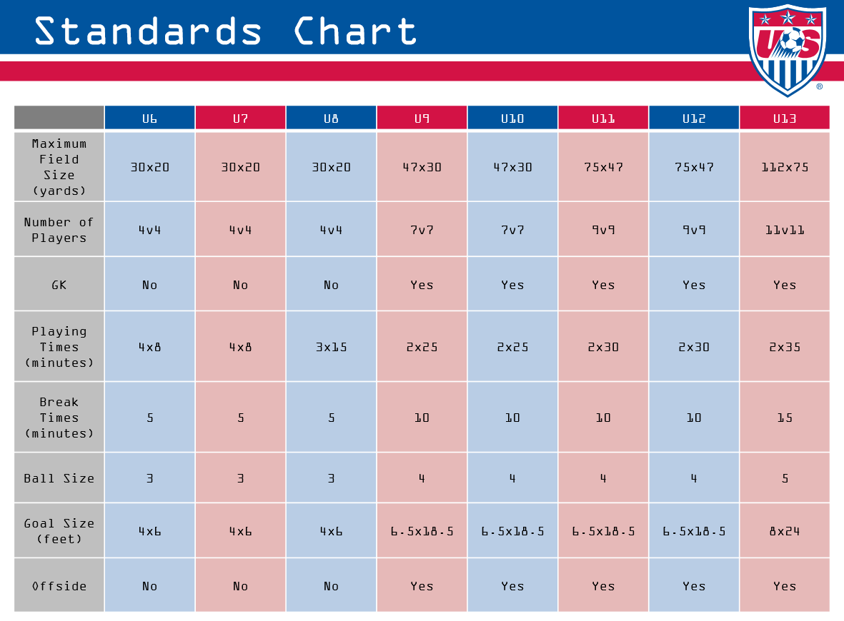
USSF Soccer Changes
Changes to smaller field sizes and number of players in 2016-2017

Slide 7
What do changes mean for PSC?
Sanatoga Park split into 2 fields in preparation for 2016-2017
Number of players per team may change due to smaller sided games.
May have multiple teams at each age group if number of participants at tryouts allows

Slide 8
Registration
One Registration for the entire year vs. registration each season
Offering Payment Plan over 6 payments
Registration will include Summer Soccer Camp
One session per week with paid trainer for travel teams

Slide 9
Registration
More Focus on Player Development through professional training for players and coaches
Mandatory Travel Camp to standardize training for all players
Payment Plan to minimize cost increase from prior seasons

Slide 10


Partnership with ProConnect Sports
Coordinate Professional Trainers for Team Training
Run Travel Soccer Camp
Provide Administration support for Travel Tryouts
Parent & Coaches Webinars
Coaching Clinic
PCA Membership
Jason Pratt, owner lives in the area.

Slide 11
Other Costs
Tournament Fees (Teams are responsible to pay for tournaments)
  Varies by tournament & number of players on team
  ~ $35 - $45 per tournament (reduced by fundraising)
Fundraising (Optional per team)
  Buyouts vs. Selling items
  Reduces cost of tournaments or other fees
Personalized Travel items (Optional by team)
  Team may purchase Ball Bag, Warm-up suits, etc.

Slide 12



Travel Specific Fundraiser
September 17, 2016 - 6pm -10pm
Sunny Brook Ballroom
Full Dinner Buffett & Cash Bar
$50 per ticket/10 people per table
Expect to give back $15+per ticket sold to each travel team
Money to use for Tournaments, team gear or other purposes

Slide 13

Uniforms
Changing Uniforms from Adidas to Under Armor
Creating an online portal for parents to order uniforms directly from supplier
Approximately $15-$20 less than current uniform
Cost is ~ $115

Slide 14
Tryouts
Girls
  April 18th, April 20th & April 23
Boys
  April 19th , April 21st & April 23
Expected to attend at least 2 tryouts
Online Registration to open tomorrow 3/23

Slide 15

Montco Alliance
Program Highlights
Professional Coaching Staff
Appointed Director for Boys and Girls
College Guidance Program
Quality playing fields and training facilities
Video Analysis (for player and team development)
Up to 3 training sessions per week (season dependent)
Professional Goalkeeper Training
Appropriate Level Competition Platform
8-10 Tournaments per year
Established Connection with Foreign Travel Company for Foreign Trip (U14)
Seminars/Workshops (Concussion/ACL Prevention/Nutrition/Hydrotherapy)
For U13 and above players looking for Elite Soccer Development
Allows PSC Travel Players to participate in ADA Development Camps/Programs

Slide 16
Questions?

